Slide 1
COMP8715
The Cinema Project

Slide 2
Table of Contents
01
Introduction
05
04
Resources
02
Project Client Map
Team Charter
03
06
Risk and Constraints
User Story Map and Schedule

Slide 3
01
Introduction
By Yuliang Ma

Slide 4
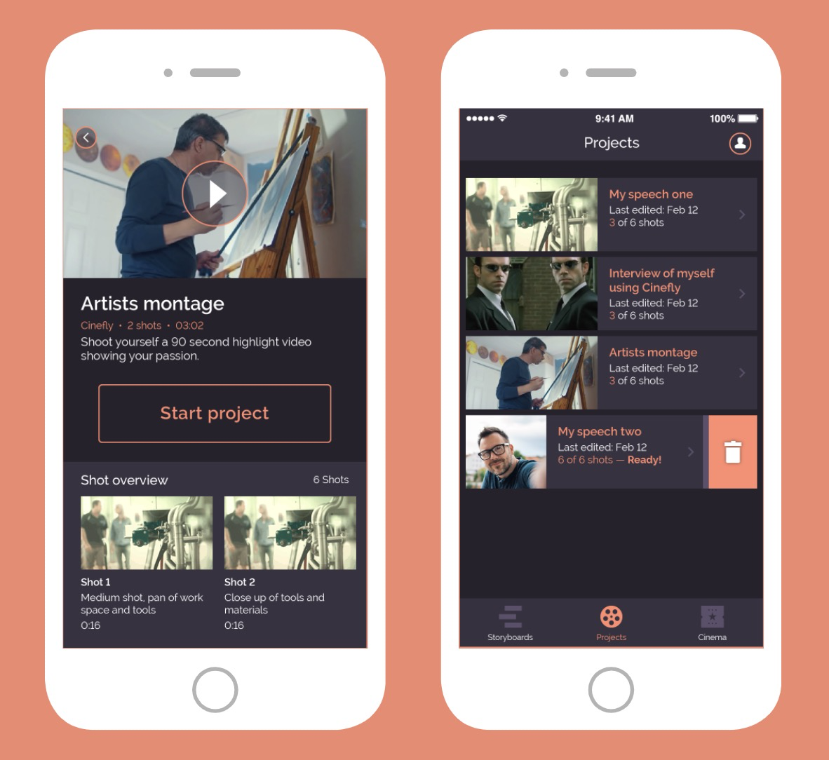
About Our Client - Cinefly
Filming guideline
Key Features
Storyboard
Post-processing patterns
Customized guideline generation
Customized Services Based on User Profile Database
Advertising
We are working on!

Slide 5
Project Goal
Basic Tasks
Bonus Tasks (Not in MVP)
A set of machine learning algorithms that can extract key information from given videos to automatically create user profiles
A database to store extracted demographics, psychographics, and behavioristics information

Slide 6
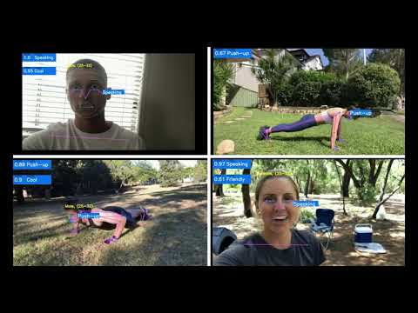
Project Goal
Finished Tasks
To Do in This Semester
Use NLP technology to process the remaining labels

Slide 7
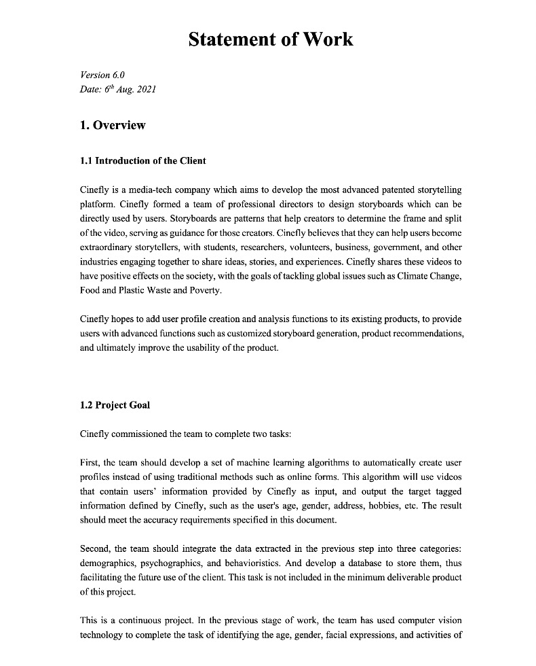
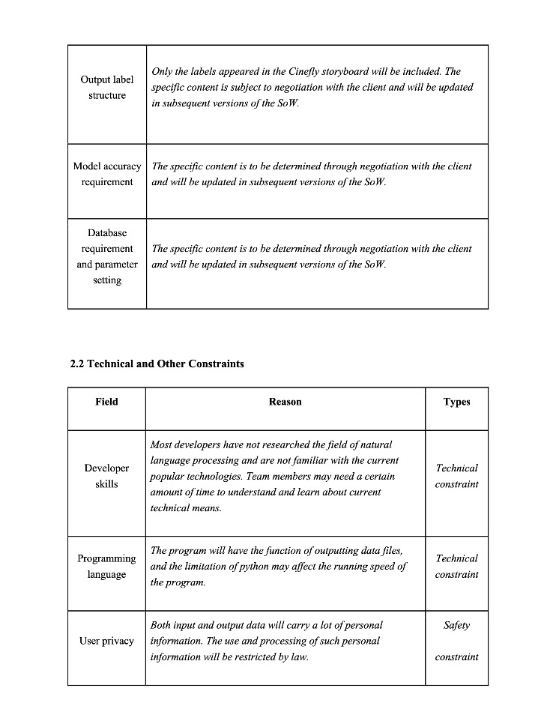
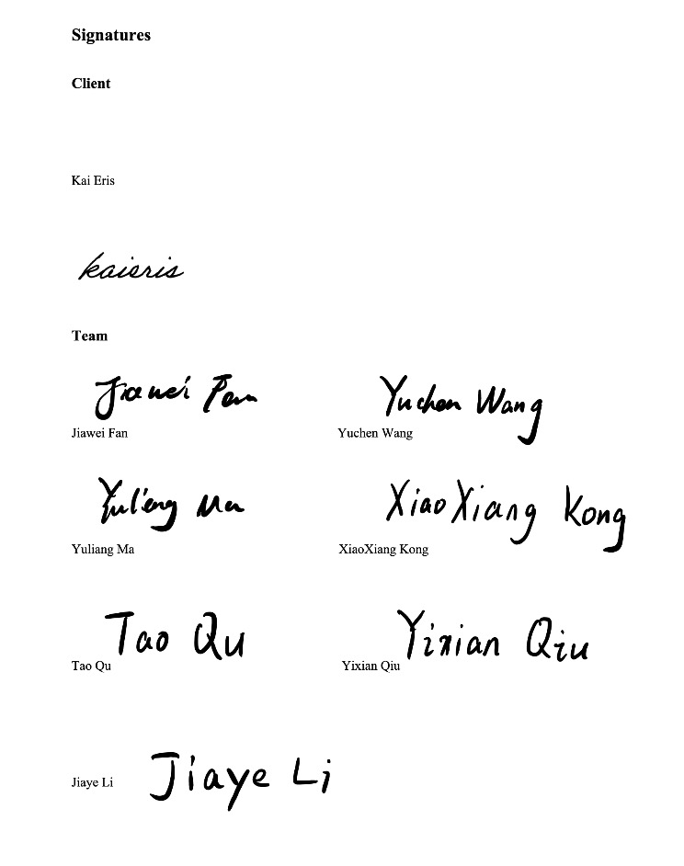
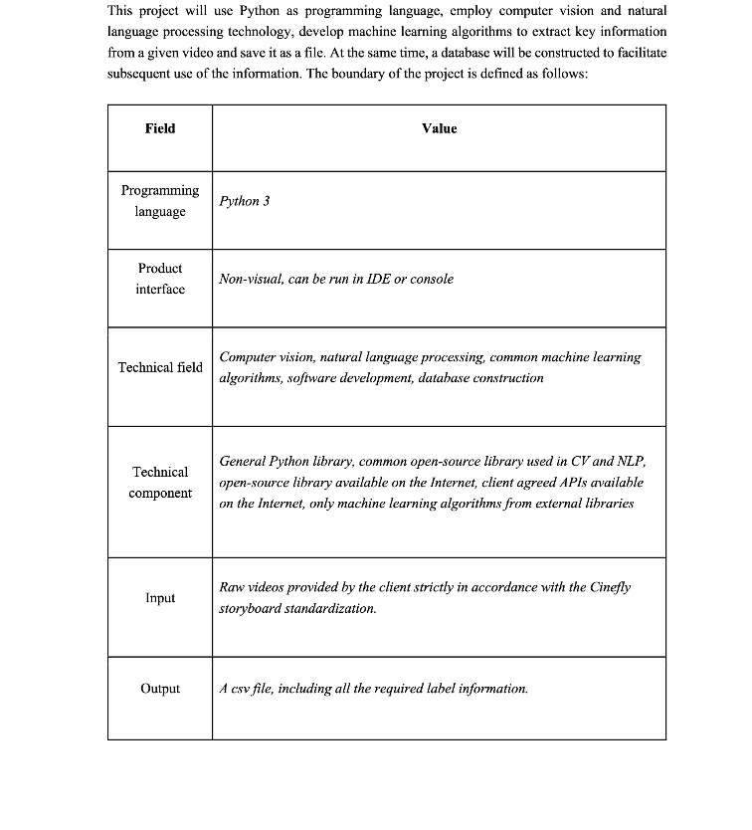
Initial Documents of the Project
Statement of Work
Project Scope
Document Repository: https://github.com/ch4ser/21-S2-2-C-Cinema

Slide 8
02
Project Client Map
By Xiaoxiang Kong

Slide 9
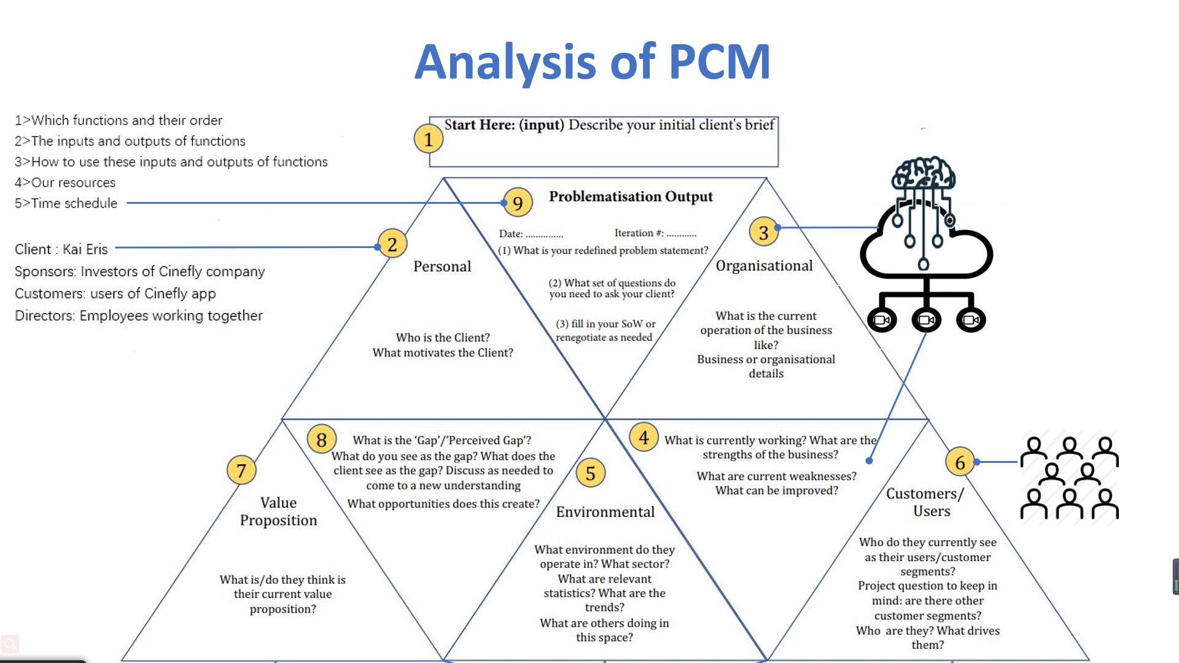

Slide 10
03
Risk & Constraints
By Yixian Qiu

Slide 11
Risk Control
Risk Label
How to control...
Development Plan
Development Environment
Product
Personnel
Client
Risk Register
Risk Solution chart
Responsible Distribution
Potential Cost Evaluation

Slide 12
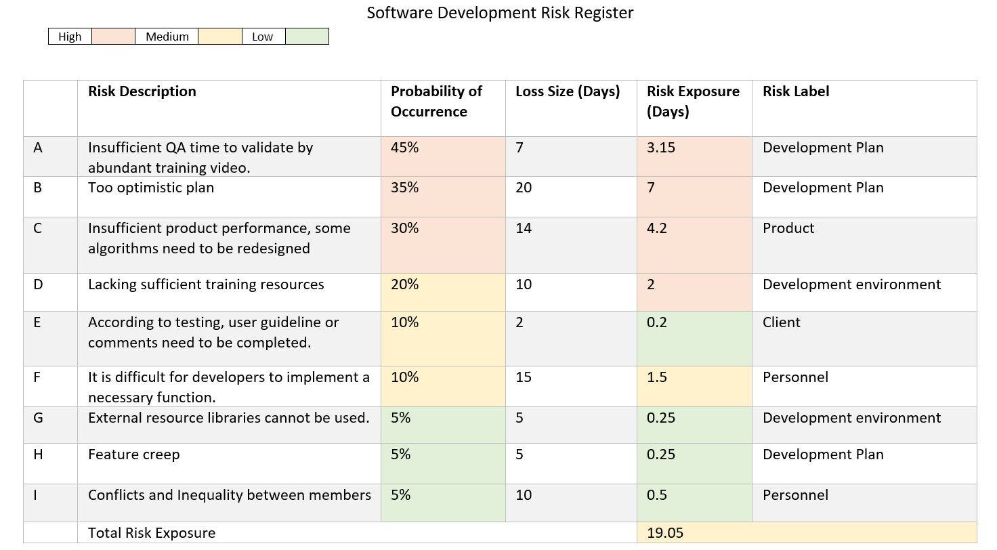
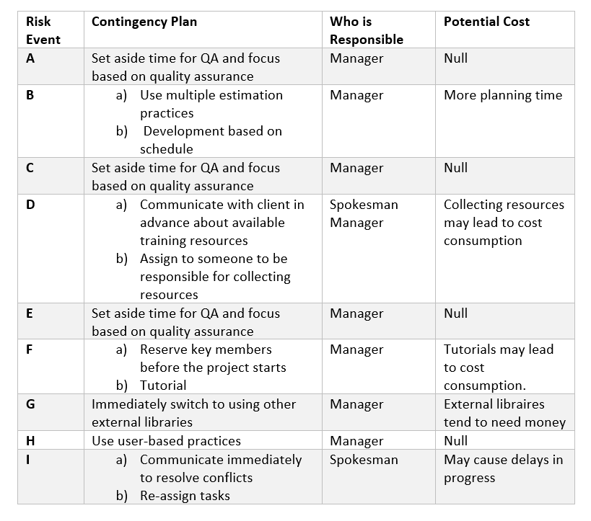
Risk Register and Solution Tables
Risk Solution Table
Risk Register Table

Slide 13
Constraints
Technical
Safety
Developer skills
Programming Language
User Privacy

Slide 14
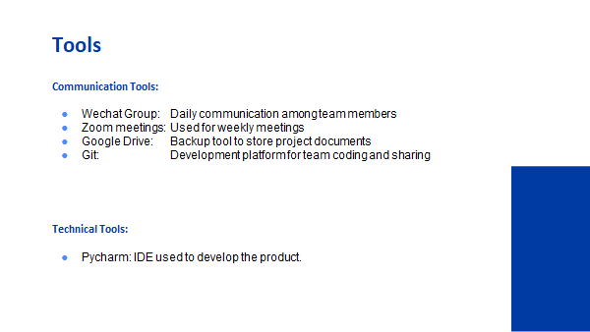
04
Resources
By Tao Qu

Slide 15
Tools
Communication Tools:
Wechat Group: Daily communication among team members
Zoom meetings: Used for weekly meetings
Google Drive: Backup tool to store project documents
Git: Development platform for team coding and sharing
Technical Tools:
Pycharm: IDE used for developing the product.

Slide 16
Resources
From Client
From ANU
Videos in the Database
Materials in ANU library
Resources from TechLaunch
Internal
Open-Source Project
Paid Services
External
Open-source algorithms or codes from online communities
AWS
Google
Others

Slide 17
05
Team Charter
By Jiaye

Slide 18
Team rules
Attend scheduled meetings.
Actively contribute to the project.
Engage with other team members.
Work closely with the client to ensure requirements are met.

Slide 19
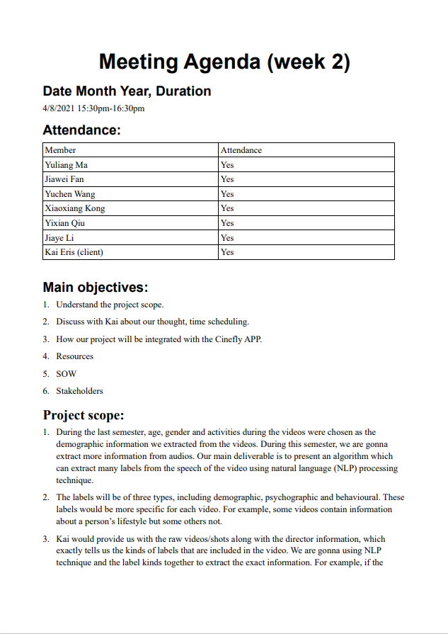
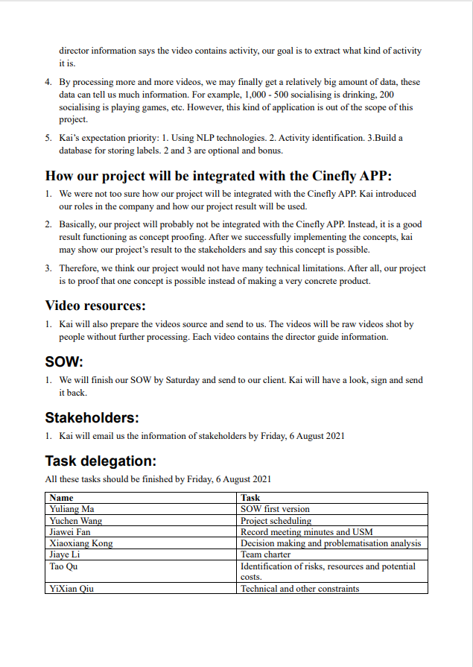
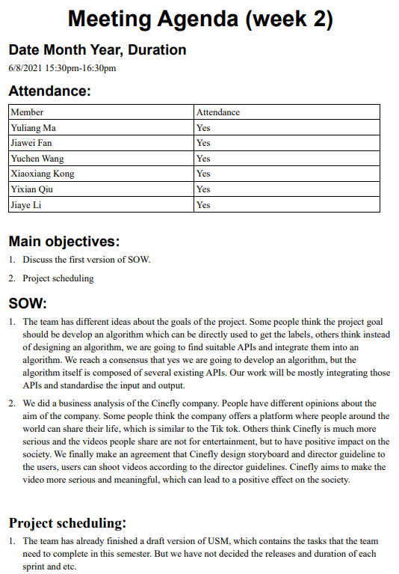
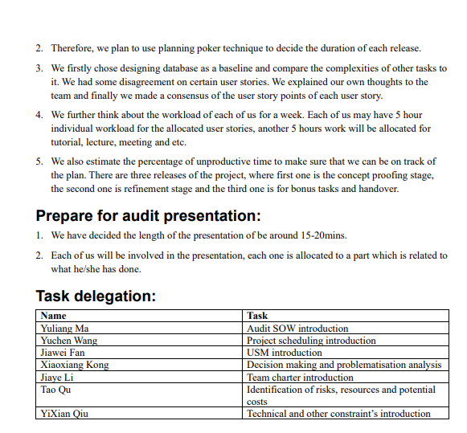
Meetings
Team Meetings
Task progress and planning
All members expected
Client Meetings
Reporting and adjustments
Spokesperson required
Tutorial
Reporting
All members expected

Slide 20
06
User Story Map & Schedule
By Jiawei Fan and Yuchen Wang

Slide 21
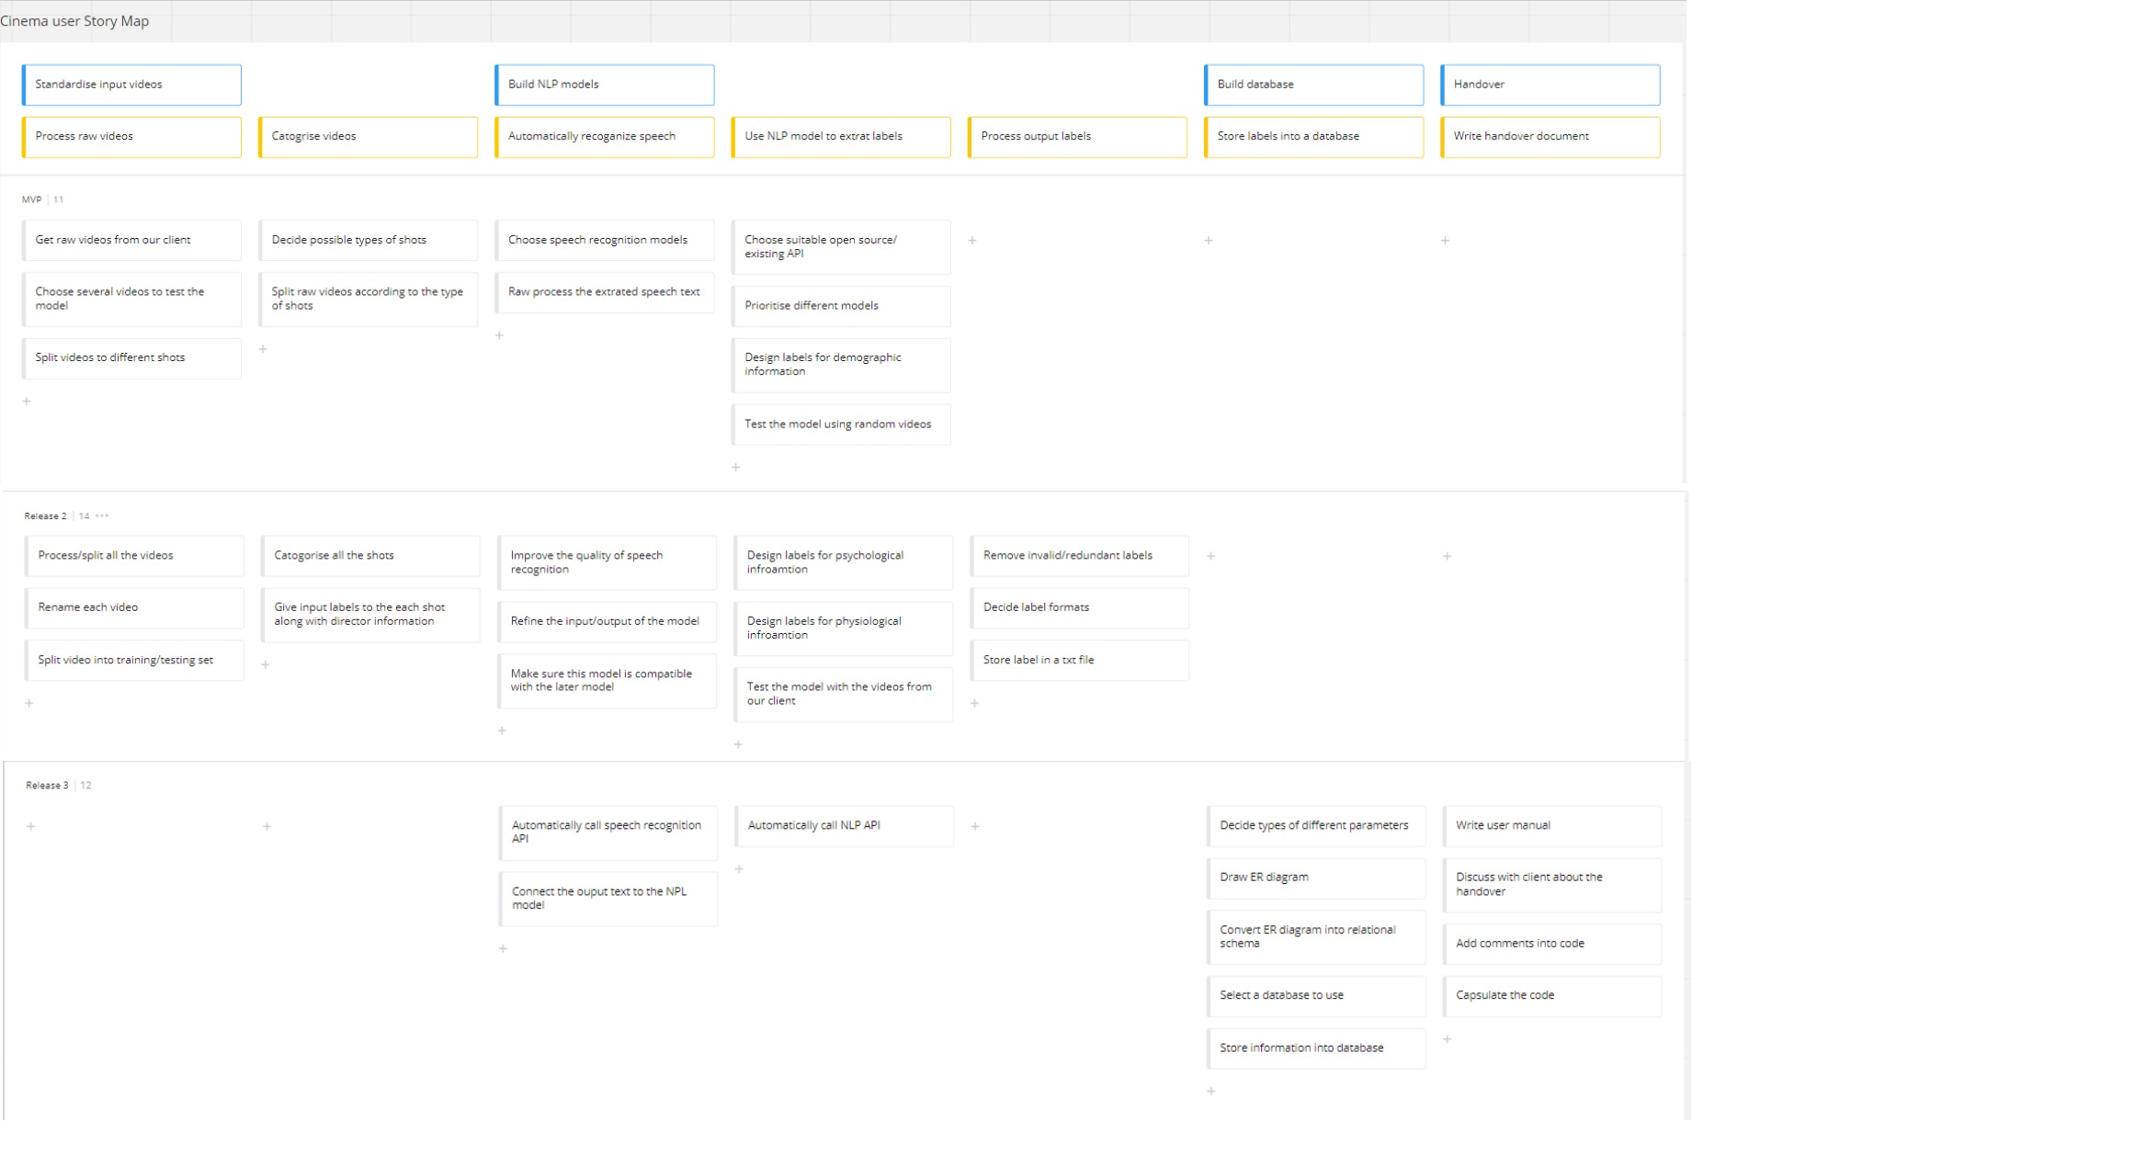
User story map(USM)
MVP/Release 1
Release 2
Release 3

Slide 22
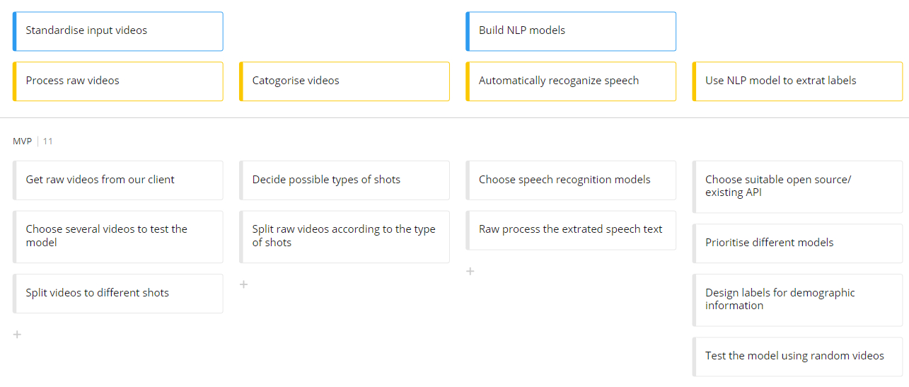
Release 1/MVP

Slide 23
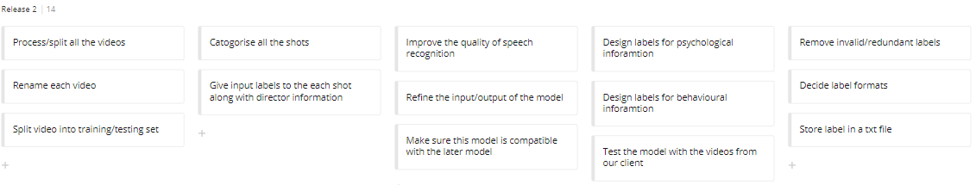
Release 2

Slide 24
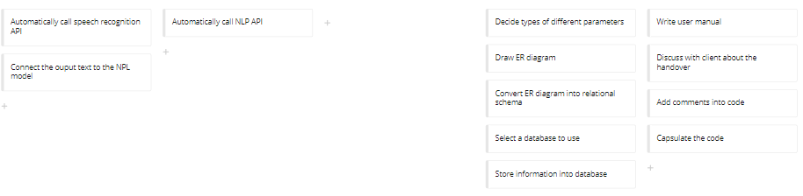
Release 3

Slide 25
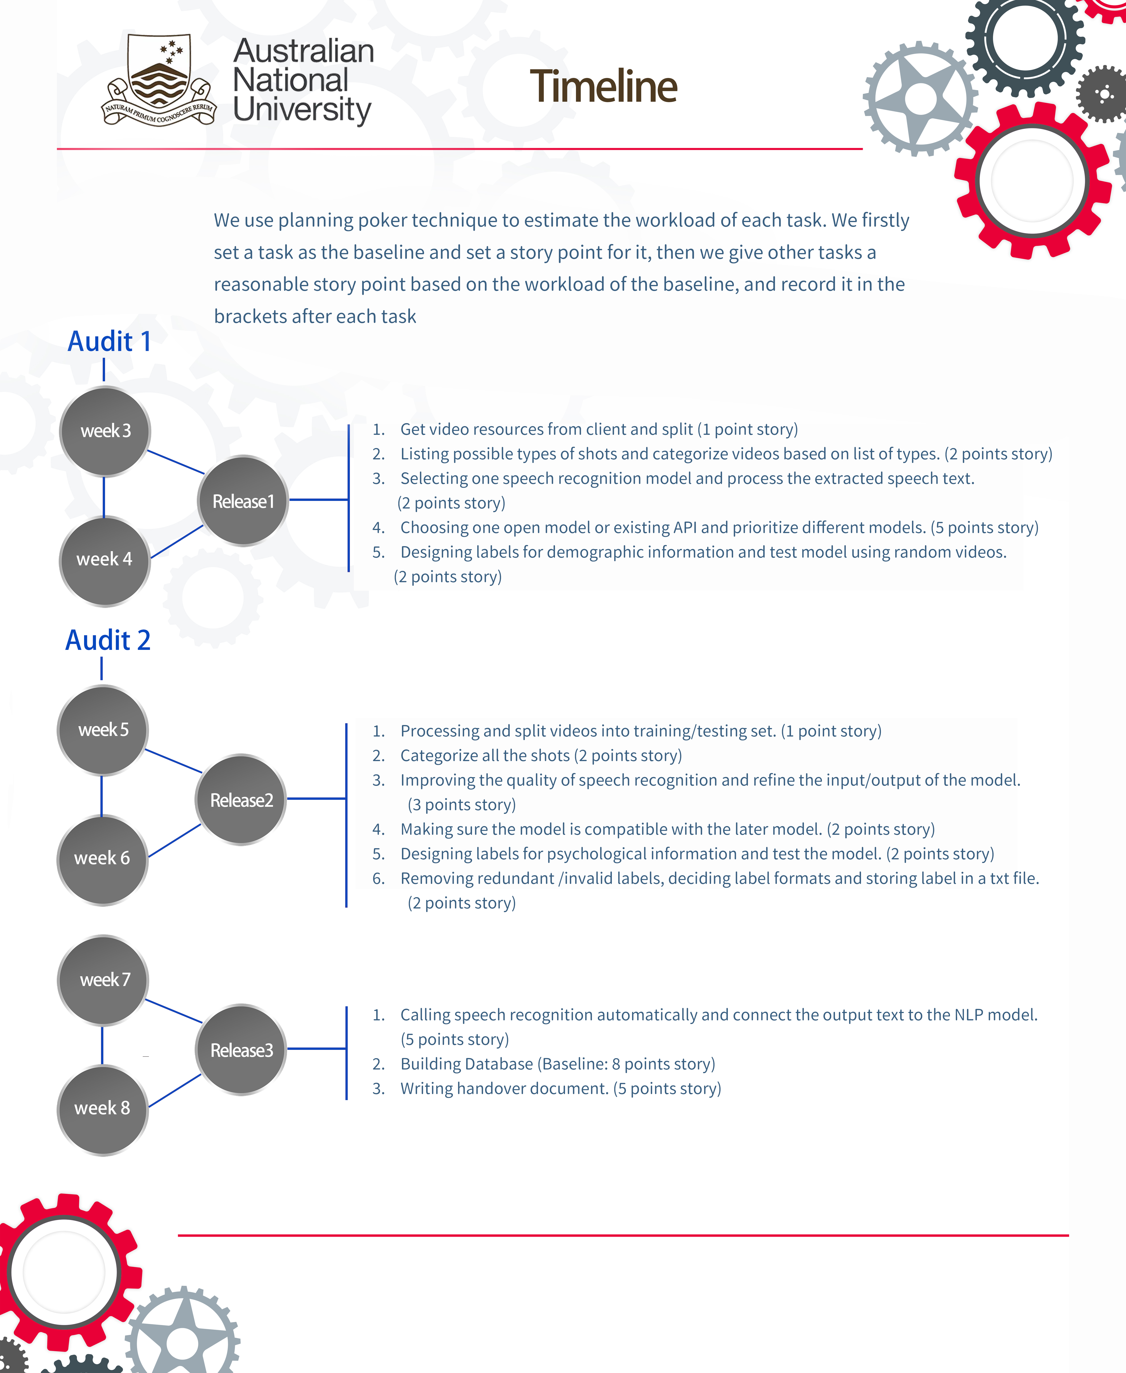
Schedule/Timeline
User Map
Tasks
Timeline
Deliverables
3 Releases
Ordering
Estimating
Planning Poker Technique

Slide 26
Reason of using Planning Poker
Process of using Planning Poker
Improving estimate accuracy.
Better compensating for missing information.
Good way to reach consensus.
Step1
Picking a task as baseline and set a baseline story point.
Step2
All members gives story points to the other task based on the baseline.
Step3
1. Members' opinions are quite different: explain corresponding reasons and repeat step 2 untill we reach consensus.
2. Members' opinions are similar: choose a median as final result.

Slide 27
Thanks for Listening

